Slide 1
Practical Malware Analysis
Chapter 7. Analyzing malicious Windows programs
Presenter Heejun Jang

Slide 2
What we will learn in Ch 7.
Basic Windows coding concepts [1].
Malware can use the concepts to execute code without a jump or call instruction.
Windows functionality most relevant to malware analysis.
Malware can use the Windows functionality for malware’s purpose.
Be familiar with Windows functionality to analyze malware and understand the purpose of malware.
[1] Windows app development documentation, https://learn.microsoft.com/en-us/windows/apps/
Notes:
윈도우에서 제공하는 functionality의 종류에 대해서 언급. 해당 functionality에서 자주 사용되는 WindowsAPI에는 뭐가 있는지, Malware가 사용했을 때 어떤 결과를 유도할 수 있는지를 미리 알아두면 추후 분석 및 멀웨어 의도파악에 많은 도움이 된다.

Slide 3
Main contents in Ch 7.
Windows API terminology
Ways that malware can modify the host system and how you can create host-based signatures.
Windows Registry, Networking API
Different ways that a program can execute code located outside the file you’re analyzing.
Dll, process, thread(mutex), services, component object model
Discussion of how malware acts stealthily.

Slide 4
Windows API
Windows API is a broad set of functionality provided by Windows, the API allows a computer program to access the features of OS.
Malware can interact with the operating system’s features and functionalities using API.

Slide 5
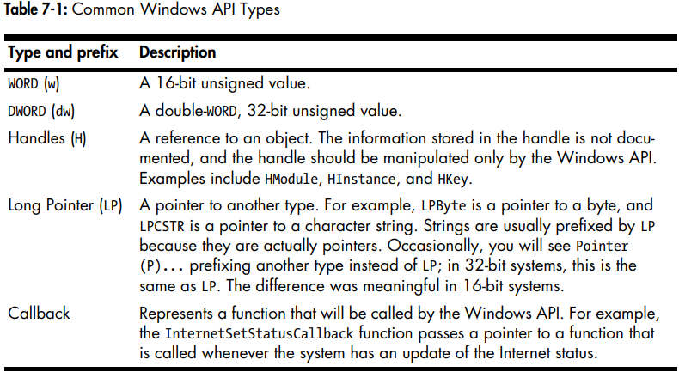
Common Windows API Types
Notes:
P 와 LP 차이 -> 16bit system일 때, P는 가까운 16bit 크기를 가지는 pointer를 지칭, LP는 16bit보다 더 큰 pointer를 지칭, 32bit system 이후로부터는 기능적으로 동일
어떤 이벤트에 발생함에 따라 Windows에 의해 호출되는 함수

Slide 6
File System functions
File activity, one of the most common ways that malware interact with system can hint at what the malware does.
If malware creates a file and stores web-browsing habit in that file, it is probably some form of spyware.
Functions for accessing the file system [2, 3].
CreateFile: used to create and open file, controls whether the function creates or opens using “dwCreationDisposition” parameter.
ReadFile and WriteFile: used to read and write files.
CreateFileMapping and MapViewOfFile: loads a file from disk into memory and returns a pointer to base address of the mapping object.
used to replicate the functionality of Windows loader.
[2] Windows API Fileapi.h overview, https://learn.microsoft.com/en-us/windows/win32/api/fileapi/.
[3] Windows API Winbase.h overview, https://learn.microsoft.com/en-us/windows/win32/api/winbase/
Notes:
Activity -> create, modify, distinct filename, change existing file name
dwCreationDisposition -> 1 -> create_new (이미 존재한다면 fail), 2 -> create_always (이미 존재한다면 덮어씌움) 3 -> open_existing -> 존재하지 않는경우 실패 4-> open_always -> 존재하지 않는경우 새로 생성 (1), 5-> truncate_existing -> 파일 열어서 내용물을 비움, 없다면 fail
ReadFile 40 이후 다시 ReadFile을 호출한다면 41번째부터 읽기 시작. 두 함수를 사용한다고 해서 파일 내에서 이동이 쉽지는 않음
Mapping object를 얻고 나면, malware가 특정 PE file이 OS loader에 의해 로드되어 실행되도록 할 수 있음
멀웨어에 있어서 파일 액티비티는 가장 많이 사용되는 방법중 하나

Slide 7
Special Files
Special files are associated with a particular hardware device or other resource of the computer system.
Shared Files: access directories or files in a shared folder stored on a network.
File Accessible via Namespaces: Win32 device namespace, with the prefix \\. \, is often used by malware to access physical device directly.
Alternate Data Streams: allow additional data, which does not show up in a directory listing to be added to an existing file, malware author use it to hide data.
Notes:
\\serverName\share, \\?\serverName\share -> windows에 disable all string parsing, allow access to longer filename
Using namespaces, malware can read and write physical device as a file. -> normal API로 불가능한 disk modify가 가능해짐

Slide 8
Windows Registry [4]
The registry, is used to store OS and program configuration information, is a good source of host-based signatures.
Malware use the registry for persistence (auto-run for every boot) or configuration data.
Identify which information we have to be interested in with following example.
Malware try to register a program which would run each time Windows starts.
[4] Windows API WinReg.h overview, https://learn.microsoft.com/en-us/windows/win32/api/winreg/.

Slide 9
Key functions for registry
RegOpenKeyEx: gets parameters to open specified registry key and provides handle which can control opened key.
RegSetValueEx: set value to opened registry key provided by RegOpenKeyEx.
RegGetValue: get value from registry key.

Slide 10
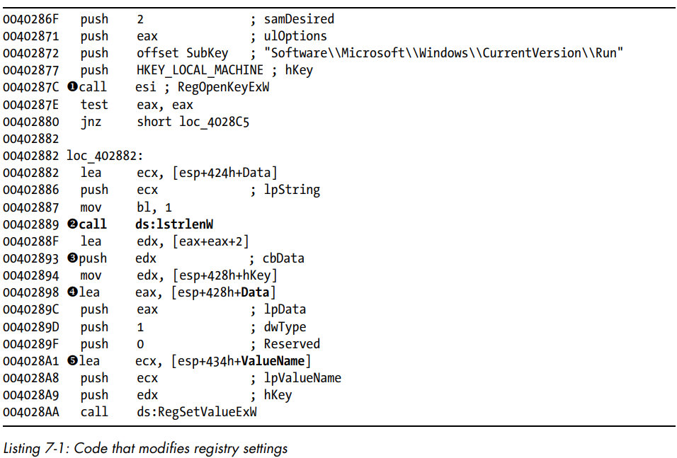
How can registry be used
Registry subkey for autorun
RegOpenKeyExw returns nonzero error code (ZF will be 0) if it fails to open registry key.
RegSetValueExW set lpData to autorun registry.
Notes:
samDesired -> 값이 2인 경우 registry create, delete, set value에 필요한 권한을 말함, uloptions -> symbolic link인지 아닌지
W, A 차이 -> unicode인지 ANSI인지

Slide 11
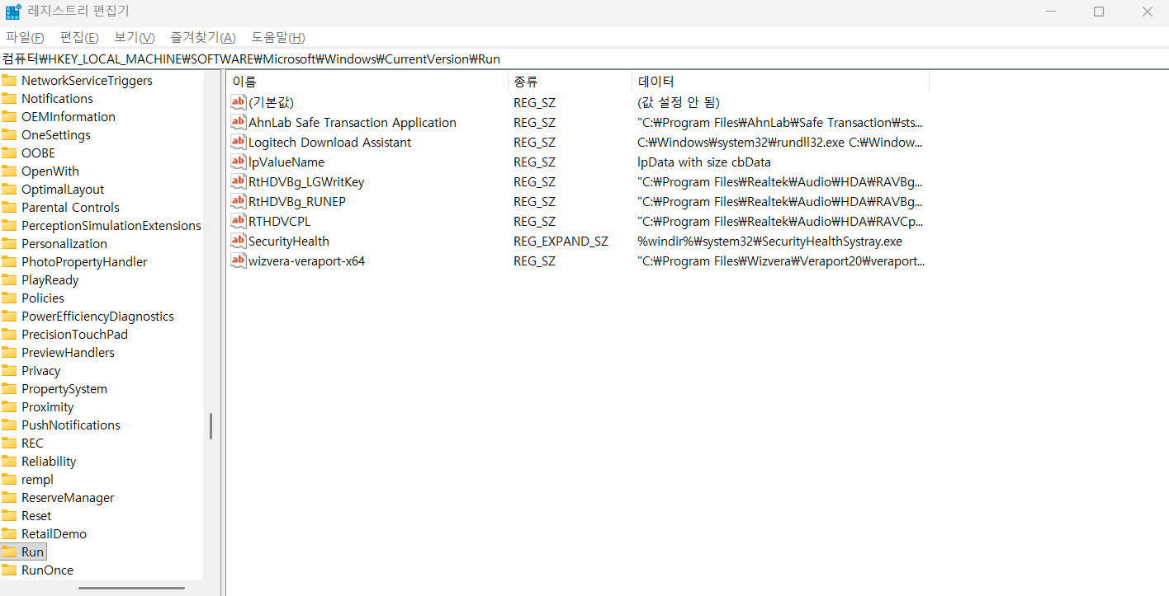
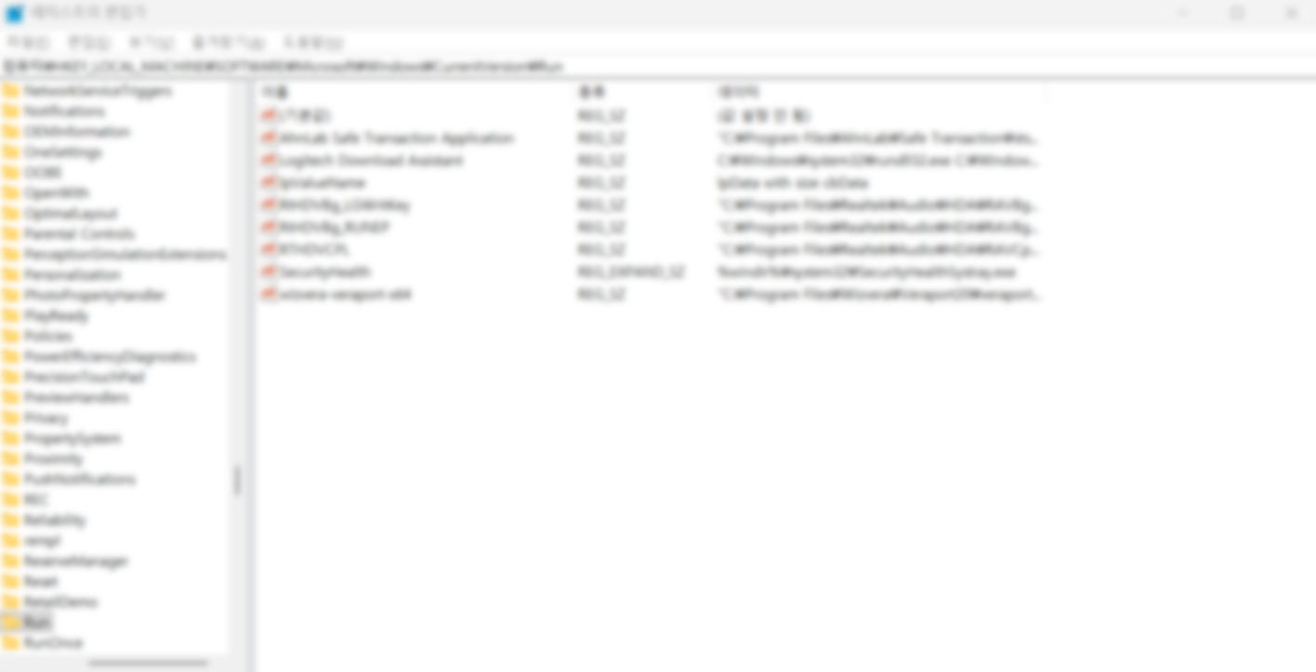
Result of Example
Can easily see registry entry using Regedit
You also can see auto-run programs with Autoruns tool [5].
dwtype 1 for REG_SZ
[5] Autoruns https://www.autoruns.org/ko/.

Slide 12
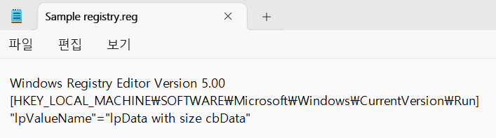
Registry Scripting with .reg files
.reg files can automatically modifies the registry by merging the information the file contains into registry with double-clicking by user.

Slide 13
Networking APIs
Malware can use Windows network api functions to do its dirty work.
Of the Windows network options, malware most commonly uses “Berkely compatible sockets” primarily in ws2_32.dll.

Slide 14
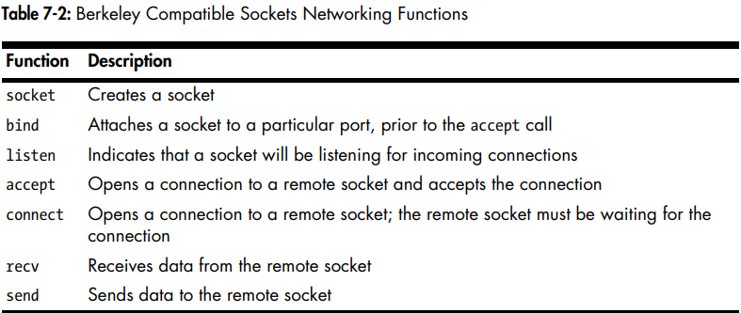
Berkely Compatible Sockets
“WSAStartup” function must be called before any other networking functions in order to allocate resources for the networking libraries. To look for the start of network connections, set bp on “WSAStartup”.

Slide 15
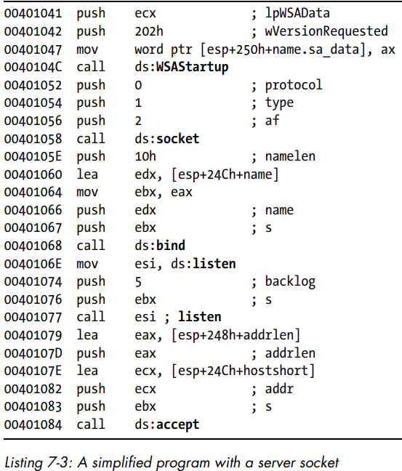
Example of network API
This example leaves out all error handling and parameter setup.
Common pattern for both malicious and non-malicious in client-side application
Realistic example would be littered with error-handling functions such as “WSAGetLastError”

Slide 16
WinINet API
WinINet API provides network functions, which are stored in Wininet.dll, for implementing protocols.
InternetOpen: initialize a connection to Internet.
InternetOpenUrl: connect a URL.
InternetReadFile: read data from a file downloaded from the Internet.

Slide 17
How to execute code located outside

Slide 18
DLL
Windows way to use libraries to share code among multiple applications.
Malware uses DLLs in three cases:
Store malicious code in malicious DLLs.
Use specific function in Windows DLLs.
Use third-party DLLs.
Analyzing DLLs, monitoring how a DLL loads and what it does, Detecting a loaded locations are helpful to reveal the malicious intent.
Use “DllMain” for analyzing start point.
“LoadLibrary”, or “GetProcAddress” are used when dll is loaded.

Slide 19
Process
Malware can execute code outside the current program by creating a new process or modifying an existing one.
Its own independent process or executing its code as part of another process.
“CreateProcess” is a function most commonly used by malware

Slide 20
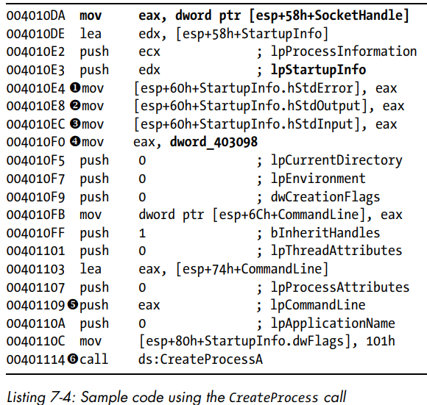
Example of process in malware
dword_403098, used as a parameter of CreateProcess function, contains the command line of the program to be executed
CreateProcess will create a new process so that all input and output are redirected to a socket.
Find remote host -> check socket handle
Which program runs -> check dword_403098

Slide 21
Process
Malware often create a new process by storing one program inside another in the resource section.
The program will extract the additional executable from the PE header, write it to disk, and then call “CreateProcess” to run the program.
Use Resource Hacker utility [6] to analyze the program
[6] Resource Hacker utility, https://www.angusj.com/resourcehacker/.

Slide 22
Thread
“CreateThread” function is used to create new threads and the function’s caller specifies a start address (start function).
Malware can use “CreateThread” as following.
Load a new malicious library into a process. In this case, start function will be “LoadLibrary”.
need to analyze

Slide 23
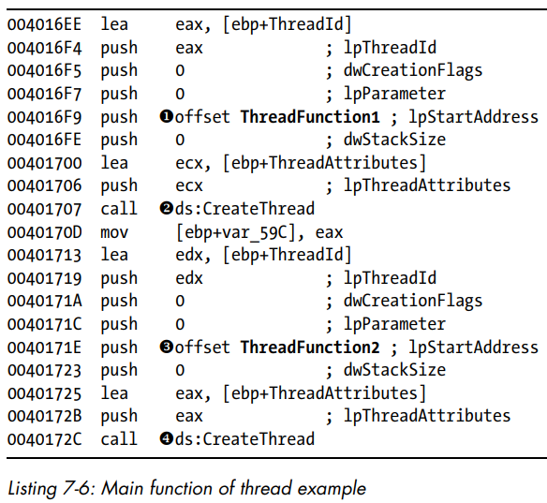
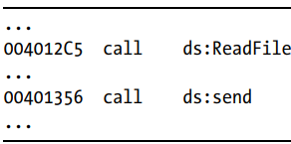
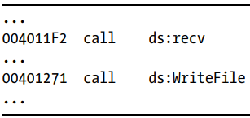
Example of thread in malware
Start function for first CreateThread
Thread for output
Start function for second CreateThread
Thread for input

Slide 24
Mutexes
Mutexes are mainly used to control access to shared resources, and are often used by malware.
Malware use the mutexes for single instance control, reinfection prevention, component coordination, persistence, and reconnaissance.
Mutexes often use hard-coded names, so they are important to malware analysis (good host-based signatures).
Modern malware uses dynamic, unique names to evade detection

Slide 25
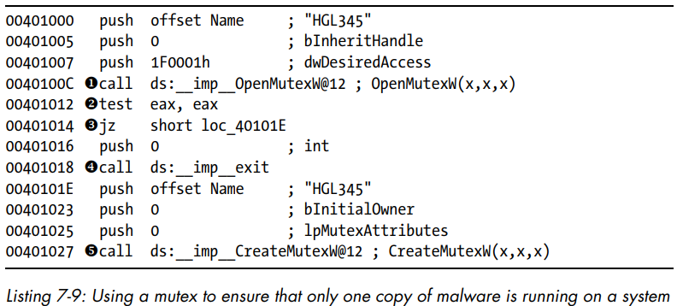
Example of mutexes in malware
Check whether the system is infected or not. If the system is infected test eax, eax set ZF 0, call exit function
Create new mutex to prevent reinfection by other malware instance
Check the mutex has random, unique or unusual name, created by unsigned creator, concerns with persistence or network activity.

Slide 26
Services
Windows allows tasks to run without their own processes or threads by using service.
Malware uses services to maintain persistence (with autorun on boot) and to run with high-level system privileges(SYSTEM).
“CreateService” and “StartService” functions are prime target of malware.

Slide 27
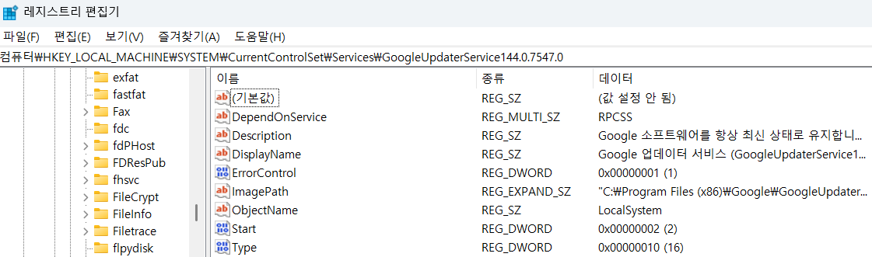
Registry entry for services
The information about services on a local system is stored in registry.
①
②
③
① is the location which the code of service is stored at. ② means AUTO_START. ③ means WIN32_OWN_PROCESS
Notes:
Service를 위한 Code를 dll에 저장하여 사용하는 타입인지, exe에 code를 저장하여 실행하는 타입인지

Slide 28
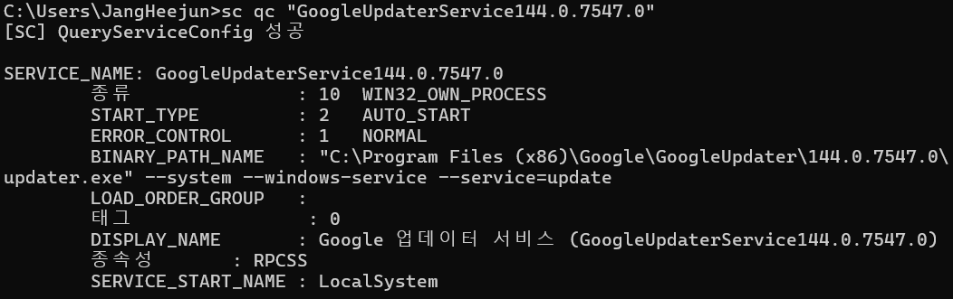
SC program for services
Using SC program, it is possible to query a service’s program with service name.
SC has command for adding, deleting, starting, stopping and querying services.

Slide 29
Component Object Model
COM is an interface standard that makes it possible for different software components to call each other’s code.
“OleInitialize” and “CoInitialize” are key functions to determine whether a program is using COM.

Slide 30
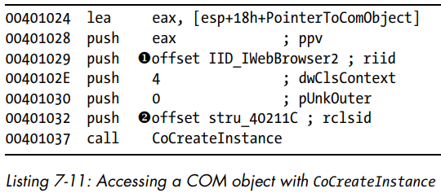
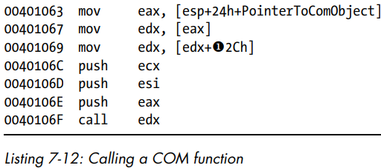
CLSIDs and IIDs
To analyze which function of COM objects is used, a couple of identifiers are needed.
Use Internet Explorer class and IWebBrowser2 interface
Use function which is in offset of 0x2C in the table of function porinters. (in this example, Navigate func)
Notes:
If malware COM objects are used, the hijacked the legitimate clsid by overwritten in HKCU registry

Slide 31
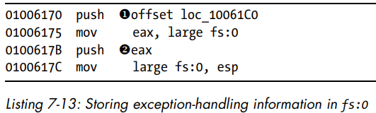
Exceptions
Exception is an event which allows a program to handle events outside the flow of normal execution.
“RaiseException”, “UnhandledExceptionFilter” are key functions.
An address on the stack which stores the exception information.
Malware can overwrite the information using stack-overflow.
Notes:
이후 챕터에서 좀 더 자세하게 다룰 예정

Slide 32
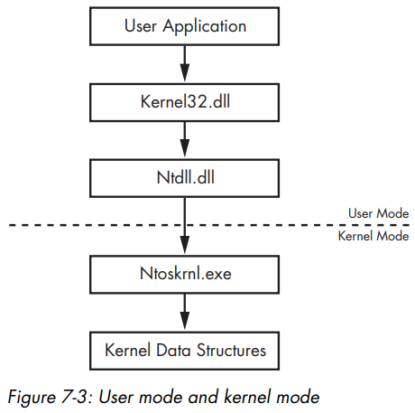
Windows API workflow
User application calls a function from Windows API.
CreateProcess is one of the functions included in Kernel32.dll
The function makes a system call to native function in Ntdll.dll (change user to kernel)
NTCreateProcess is called when user use CreateProcess function.
Once in kernel mode, Ntoskrnl.exe takes over the control and performs the privileged operations.

Slide 33
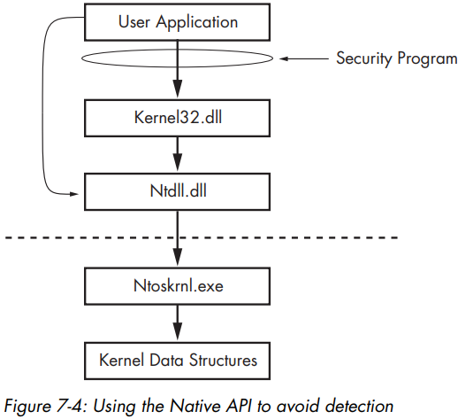
How malware acts stealthily
Security program monitors the system calls made by a process.
If malware call the Native API function directly, it may be able to evade poorly designed security program.
NtCreateThreadEx, NtQuerySystemInformation, NtContinue are often targeted by malware.
Notes:
Malware uses an assembly wrapper to place SSN for desired NT function into eax register, setup parameters on a stack, execute syscall instruction
최신 security 프로그램의 경우 ntdll을 hooking 하거나 behavior monitoring 하면서 이러한 케이스를 잡아냄
NtContinue : malware use it to confuse an analyst and make a program more difficult to debug.

Slide 34
Conclusion
Ch 7. shows Windows concepts which are important to malware analysis.
Many of the specific malware examples discussed in Ch 7. are common case, these cases help to recognize and understand malwares quickly.

Slide 35
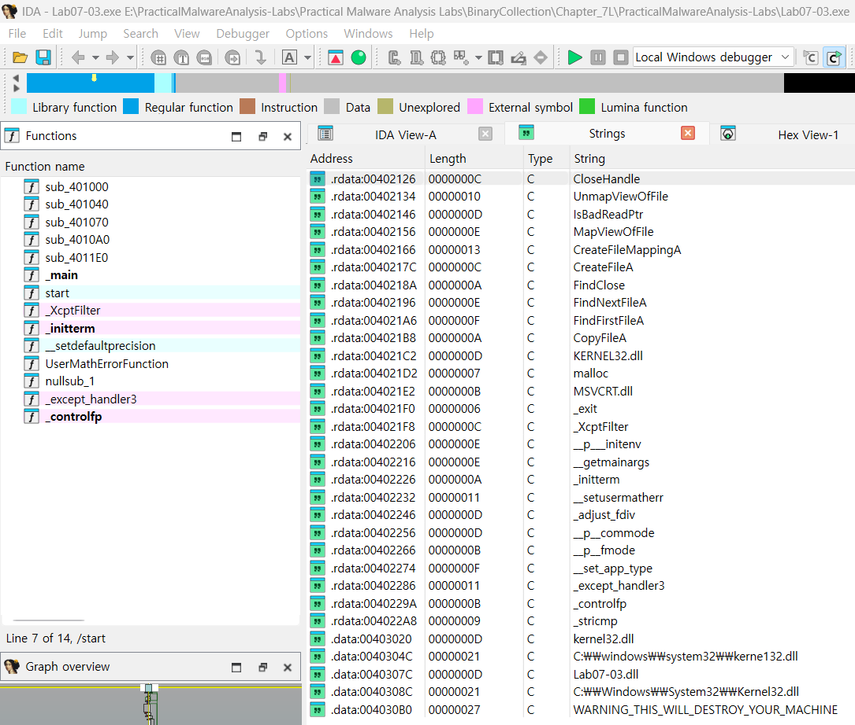
Lab 7-3 (in exe)

Slide 36
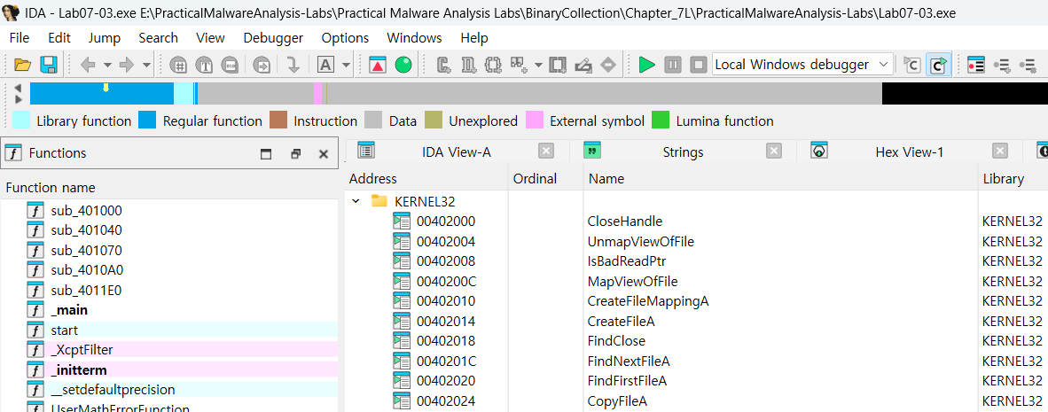
Lab 7-3 (in exe)
probably opens a file and maps it into memory.
probably searches directories.
probably copy files.

Slide 37
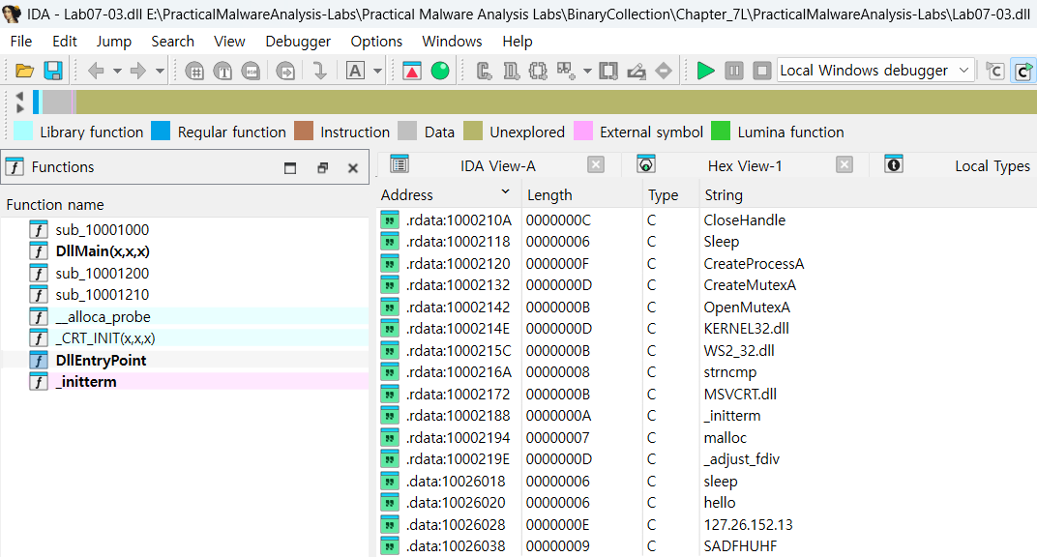
Lab 7-3 (in dll)

Slide 38
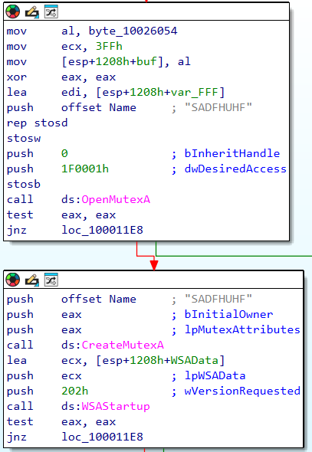
Lab 7-3 (in dll)
Use random, unique, and unusual string for mutex, it will be malware.
This malware will use any other network function

Slide 39
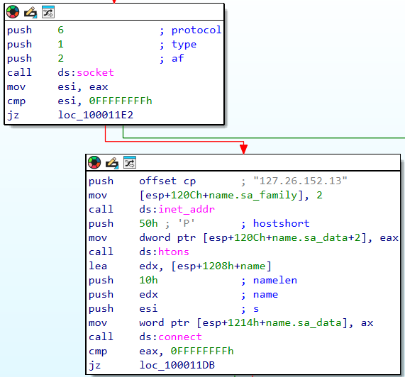
Lab 7-3 (in dll)
Malware will use socket function with tcp protocol.
Malware try to connect to 127.26.152.13 with port 80.
Notes:
Htons -> host to network short

Slide 40
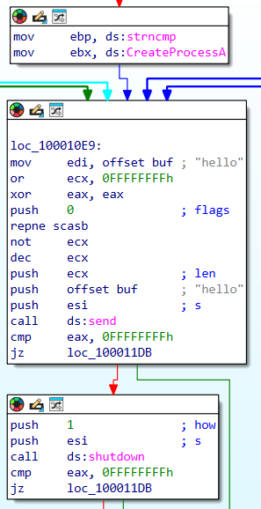
Lab 7-3 (in dll)
Malware will send “hello” to malicious server (127.26.152.13).
Malware makes the socket state to half-close connection.

Slide 41
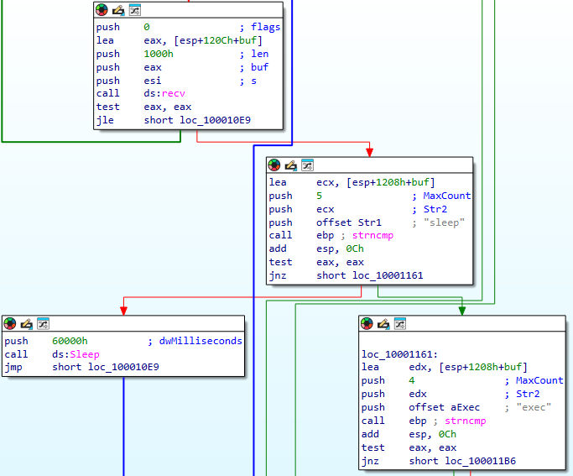
Lab 7-3 (in dll)
Malware will store incoming network traffic on the stack.
Malware check first 5 characters are “sleep”. If equal, test eax, eax will set ZF 1
Malware will call sleep functions with paratemer 16^4 * 6 milliseconds(394s)

Slide 42
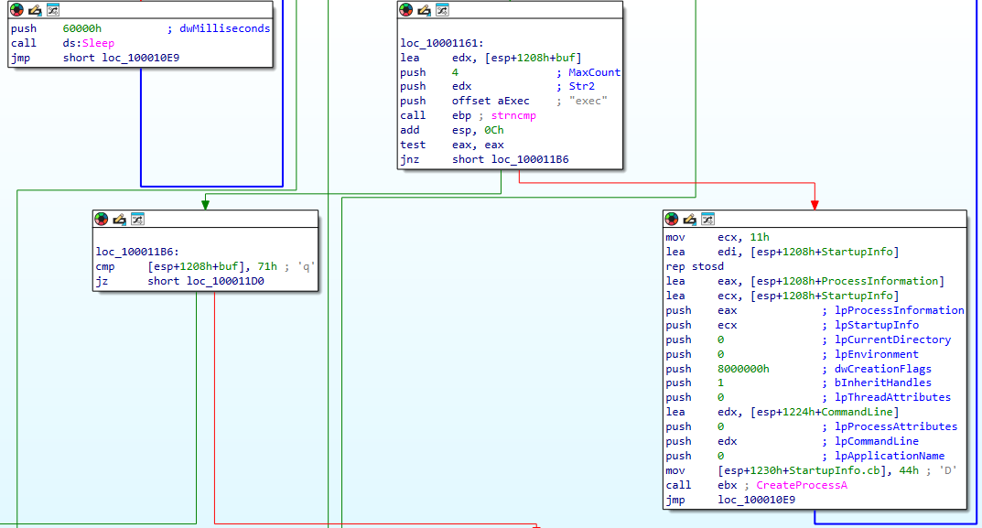
Lab 7-3 (in dll)
Check first 4 characters are “exec”
No “exec”
Create process which will do command-line

Slide 43
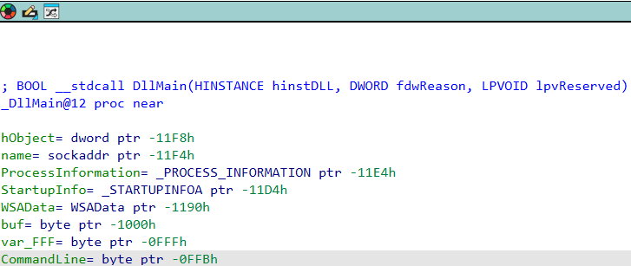
Lab 7-3 (in dll)
In network traffic from malicious server, 5bytes something is transferred through socket, malware will create a process which do something
The received from malicious server through socket would be
“exec XXXXXXXXXX”
buf CommandLine

Slide 44
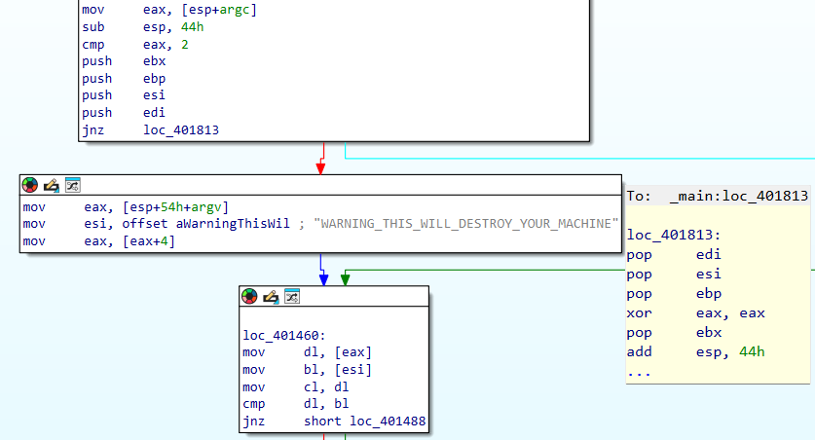
Lab 7-3 (in exe)
Check whether argument count is 2.
If count is 2, ZF set to 1
main exit
Check whether argv[1] is equal to above string. If same, ZF set to 1

Slide 45
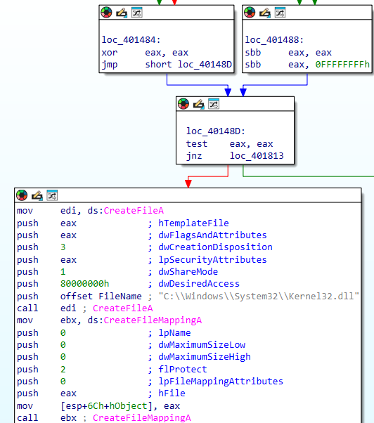
Lab 7-3 (in exe)
If argv[1] is Warning ~ string, the eax register is set to 0.
test 0, 0 will set the ZF to 1.
Malicious code will start.

Slide 46
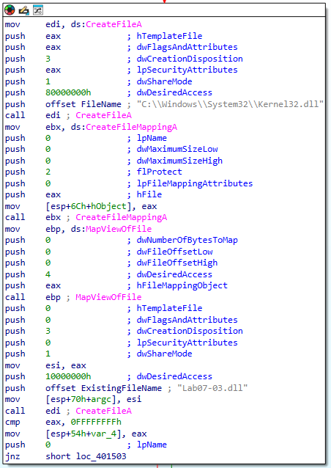
Lab 7-3 (in exe)
Malware try to open kernel32.dll if the file exists (dwCreationDisposition 3).
Malware try to open Lab07-03.dll if the file exists (dwCreationDisposition 3).
Notes:
가운데 createfilemapping과 mapoverview는 Windows loader의 기능을 복제하는데 주로 사용

Slide 47
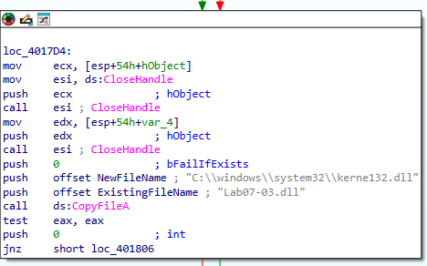
Lab 7-3 (in exe)
Malware copies Lab07-03.dll to kerne132.dll

Slide 48
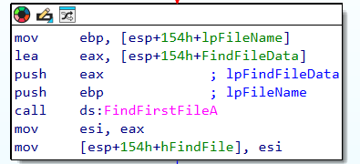
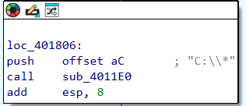
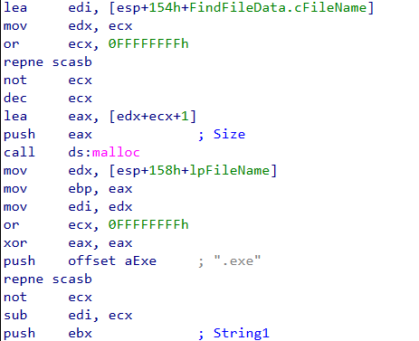
Lab 7-3 (in exe)
Find all files in C drive which name is end with “.exe”

Slide 49
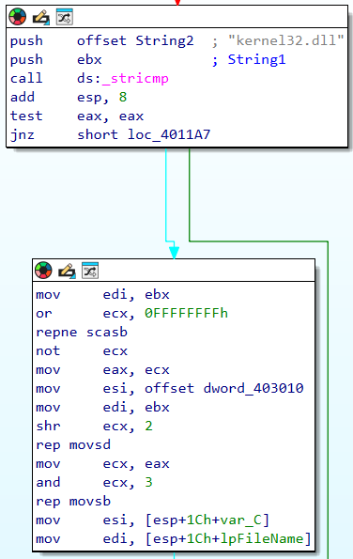
Lab 7-3 (in exe)
The result of comparing “kernel32.dll” and String1 (KERNEL32.DLL) is save to eax by stricmp. If strings are equal (case-insensitive), eax set to 0, then test eax, eax set ZF to 1.
or ecx, 0FFFFFFFh set to ecx as 0xFFFFFFFF
repne -> repeat if ecx is Not Equal to 0
scasb -> scan string 1byte of eax(0) and compare edi(kernel32.dll\0). If not equal, do ecx – 1, if equal stop.
not ecx will return the length of string in edi (ecx set to 13)
Esi points the address 403010 to use in movsd
rep -> repeat as ecx count
movsd -> set value in esi address to edi with dword unit
In here, ecx is 3 (13 >> 2), so 12 bytes of esi address string will copy into edi (kernel32.dll except null).
rep movsb -> copy null string.
After this step, kernel32.dll should change to xxxxxx32.dll

Slide 50
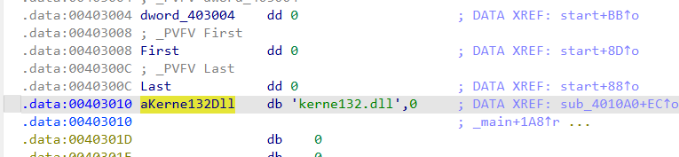
Lab 7-3 (in exe)
When press A in ida pro, we can know that the string is kernel132.dll
Finally, we know that this malware changes kernel32.dll string into kerne132.dll in all exe files in C drive, which create process using malicious command from malicious server.

Slide 51
Lab 7-3 Questions
How does this program achieve persistence to ensure that it continues running when the computer is restarted? -> change files to import malicious dll file.
What are two good host-based signatures for this malware? -> kerne132.dll file and mutex name (SADFHUHF)
What is the purpose of this program? -> make the host do malicious command which come from malicious server, backdoor
How could you remove this malware once it is installed? -> backup or copy kernel32.dll to kerne132.dll.

Slide 52
Q&A

